Slide 1
CSE 461
FINAL EXAM Review

Slide 2
Help yourself to snacks

Slide 3
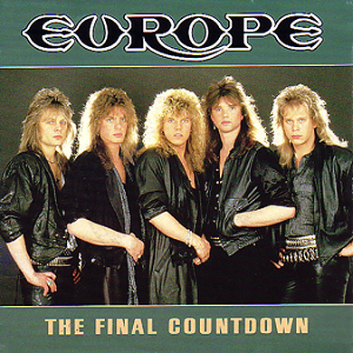
Final overview
Online final (through Catalyst)
Starts Friday, late night
Due by Monday, 5:00PM (hard deadline)
Open book, open notes, open internet, but not open people
Covers topics in lectures, project, and textbook/homework; emphasis on second half of quarter
Questions about the test should be sent to JZ/TAs by e-mail
When appropriate, we’ll post on Catalyst
Bonus Question: What are my office hour times?
Wednesdays, 1:10 to 3:00 (but not anymore!)

Slide 4
First half of the quarter
Network layers & encapsulation
Types of addresses
Ports and sockets
TCP vs. UDP
Sliding window
Analysis metrics
Error handling
Projects 0 and 1
See midterm review slides for more

Slide 5
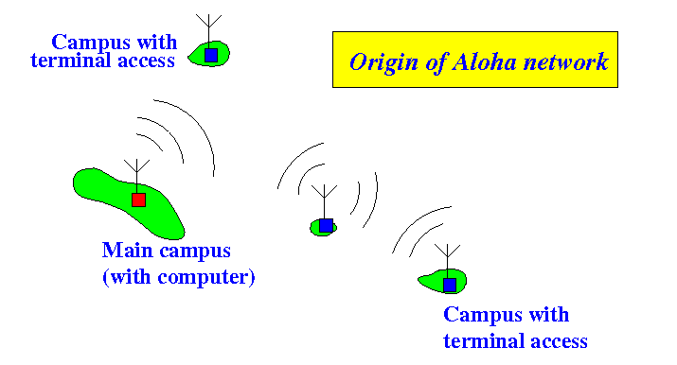
Medium access control (1)
Pure ALOHA Protocol
Used random access (collisions inevitable but traffic infrequent)
Central station rebroadcasts received frames
Frames with bad checksums are thrown away
If you don’t hear your frame, wait a random amount of time and try again

Slide 6
Medium access control (2)
Slotted ALOHA Protocol
Time is divided into discrete “slots”
You have to wait until the beginning of a new slot to transmit
Decreases likelihood of collisions, but they’ll still happen

Slide 7
Carrier sense multiple access with collision detection (CSMA/cd)
Nodes detect traffic on the line and wait to transmit until it’s clear
Collisions are detected, and a random amount of time is waited before a retransmit
Bonus question: Why doesn’t Ethernet use this anymore?
Hosts can communicate directly with Ethernet switches, completely avoiding collisions.

Slide 8
Binary exponential backoff
Wait a random number of slots between 0 and n
n starts at 1 and doubles each time there’s a collision

Slide 9
Wireless (802.11) Multiple access
802.11 (wireless) nodes use CSMA/CA (Collision Avoidance), which listens for a signal and holds off on transmitting until there is no traffic
Bonus question: why does 802.11 use a variable bitrate, while Ethernet’s bitrate is constant once configured?
802.11’s maximum bitrate can change easily; Ethernet’s cannot.

Slide 10
Hidden terminal problem
Issue that can cause wireless interference
Bonus Question: what are some ways to mitigate this?
RTS/CTS, power increases, and relocating the node/obstacles

Slide 11
Token ring networks
Nodes are arranged in a ring
Nodes take turns, passing around a token
The node with the token can talk
If a token hasn’t been seen recently, it may have been lost
When a new token needs to be generated, one node (the “active monitor”) regenerates it
If this fails, stations will contend to be the new active monitor
Bonus Question: How do you determine who gets to be the new active monitor?
Node with the highest MAC address wins.

Slide 12
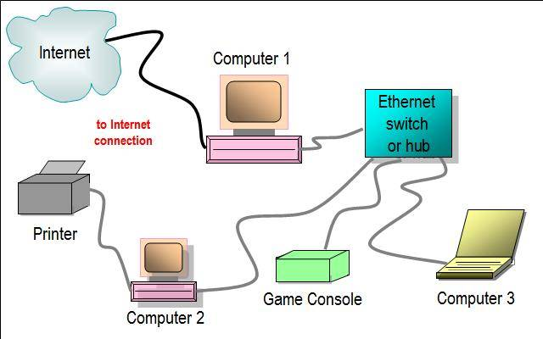
LAN hubs and switches
Bonus question: what’s the difference between a switch and a hub?
Hubs are logically equivalent to a long cable
Switches keep wires separate

Slide 13
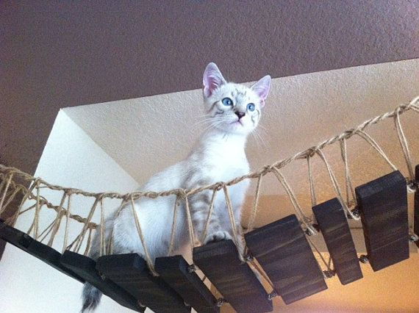
LAN BRidging
Allows two or more network segments to create an aggregate network
Simply forward received frames (as opposed to routers, which route them)

Slide 14
Spanning tree algorithm
Creates a loop-free connected graph for bridges to communicate
Node with lowest MAC is root; low MAC addresses break ties
Each node remembers shortest path to the root it sees

Slide 15
Spanning tree poem: “Algorhyme”
I think that I shall never see
A graph more lovely than a tree.
A tree whose crucial property
Is loop-free connectivity.
A tree that must be sure to span
So packets can reach every LAN.
First, the root must be selected.
By ID, it is elected.
Least-cost paths from root are traced.
In the tree, these paths are placed.
A mesh is made by folks like me,
Then bridges find a spanning tree.
-Radia Perlman

Slide 16
RFID
Store a serial number or other small amount of data
Passive tags: reflect back radio waves
Active tags: broadcast signals when woken up by nearby readers

Slide 17
Routing basics
Distributed algorithm to determine efficient paths in a network
Distributed approach
Distance vector algorithm
Link-state algorithm

Slide 18
Distance Vector algorithm
Uses Bellman-Ford algorithm
Each node maintains a table of the shortest path to each node through each node
Nodes send their full routing table to their neighbors only
When a node receives tables from its neighbors, it recalculates the shortest paths
Algorithm stops when all of the routing tables have converged
Requires lots of space for routing table storage

Slide 19
Link-state algorithm
Each node floods out packets identifying its neighbors and the metrics for the link with each neighbor (its “link state”)
Nodes construct a map of network connectivity
Nodes calculate the shortest path to every possible destination (usually with Dijkstra’s algorithm)
These paths are put into a routing table
Requires more processing power/logic to calculate link properties/metrics

Slide 20
Border Gateway Protocol (BGP)
Deals with routes between “autonomous systems”
Routers exchange information about routes to nodes
Routers maintain a shortest path vector for other routers
BGP must be manually configured; no discovery, and often based on policy

Slide 21
Classless inter-domain routing (CIDR)
Designates subnets within the IP address space
IP address of subnet followed by the number of bits that are used for routing (32 minus the number of bits free for subnet addressing)
Note: the first address in a subnet is used as the subnet address (seldom actually used), and the last address is the broadcast address.
Bonus Question: What would the broadcast address be for the subnet 24.18.4.0/24?
24.18.4.255

Slide 22
Getting Addresses with Arp and dhcP
ARP (Address Resolution Protocol) allows hosts to convert an IP address to a MAC address
DHCP allows hosts that’ve just joined a network to receive an IP address
Bonus Question: how could a hacker use ARP maliciously?
By ARPing IP addresses it hears with its own MAC address, or with non-existent MAC addresses.

Slide 23
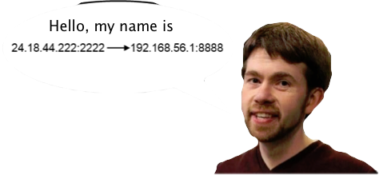
Network address translation (NAT)
Allows computers connected to a router with a single IP address to be addressed by an IP address/port pair
Bonus Question: If Alice is connecting to Bob, how can Alice and Bob tell if Alice is on a NAT?
Alice sends a packet to Bob with a payload containing a hash of her own source IP address and port. Bob hashes the source IP address and port, and sees if that hash matches the payload hash.

Slide 24
Project 2: http and TCp
What an HTTP proxy does and how it works
What HTTP packet format looks like (generally)
Why we manipulated packets to turn off keep-alive
Some basic errors that happen with TCP and how they can be mitigated

Slide 25
Project 3: TOR61
How Tor (or Tor61) works
How nodes establish connections to each other
How nodes extends work
How Tor provides privacy
Possible causes for deadlock in networked systems like Tor

Slide 26
Project 4: Bitcoins
How public/private key encryption works
What a cryptographic hash is
How cryptographic signatures work
General format of Bitcoin block chain
What would make a transaction invalid
How Bitcoin mining works
How Merkle trees work

Slide 27
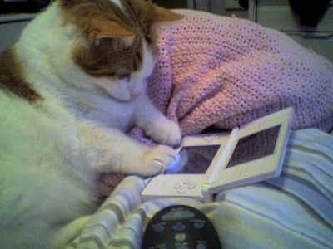
Network-related Story time
Cool feature: The Hidden
Small developer in Scotland

Slide 28
Sample problem: CIDR
What is the maximum number of hosts that a subnet can handle, if its network prefix is 192.168.176.0/20 ?

Slide 29
Sample problem: CIDR (solution)
The routing prefix is 20, which means that there are 12 bits of data that is unmasked and can be used for the network. 12 bits of data can provide 2^12, or 4096, different hosts. (Or 4094, if you don’t count the first and last addresses.)

Slide 30
Sample problem: CIDR
A router has the following CIDR entries in its forwarding table:
Address/mask | Next hop
135.46.56.0/22 | Interface A
135.46.60.0/22 | Interface B
135.46.40.0/23 | Interface C
Default | Interface D
If a packet with the IP address 135.46.63.10 arrives, where does the router forward it?

Slide 31
Sample problem: CIDR (solution)
Address/mask | Address Range | Next hop
135.46.56.0/22 | 135.46.56.0 – 135.46.59.255 | Interface A
135.46.60.0/22 | 135.46.60.0 – 135.46.63.255 | Interface B
135.46.40.0/23 | 135.46.40.0 – 135.46.41.255 | Interface C
Default | Everything else | Interface D
So a packet addressed to 135.46.63.10 would be forwarded onto interface B.

Slide 32
Sample problem: distance-vector routing
Each node maintains a vector of distances (and next hops) to all destinations
Initialize vector with 0 (zero) cost to self, ∞ (infinity) to other destinations
Periodically send vector to neighbors
Update vector for each destination by selecting the shortest distance heard, after adding cost of neighbor link
Use the best neighbor for forwarding

Slide 33
Problem
What will A’s routing table look like when it converges?
Can only talk to nodes B and E
F
To | Cost
A | 0
B | ∞
C | ∞
D | ∞
E | ∞
F | ∞
G | ∞
H | ∞
4
2
E
G
3
Initial
vector
10
3
2
4
D
1
A
4
B
2
2
H
3
C

Slide 34
Step 1
First exchange with B, E; learn best 1-hop routes
To | B says | E says
A | ∞ | ∞
B | 0 | ∞
C | ∞ | ∞
D | ∞ | ∞
E | ∞ | 0
F | ∞ | ∞
G | ∞ | ∞
H | ∞ | ∞
B +4 | E +10
∞ | ∞
4 | ∞
∞ | ∞
∞ | ∞
∞ | 10
∞ | ∞
∞ | ∞
∞ | ∞
A’s Cost | A’s Next
0 | --
4 | B
∞ | --
∞ | --
10 | E
∞ | --
∞ | --
∞ | --
F
4
2
E
G
3
10
3
2
4
D
1
A
4
B
2
2
H
Learned better route
3
C

Slide 35
Step 2
Second exchange; learn best 2-hop routes
To | B says | E says
A | 4 | 10
B | 0 | 4
C | 2 | 1
D | ∞ | 2
E | 4 | 0
F | 3 | 2
G | 3 | ∞
H | ∞ | ∞
B +4 | E +10
8 | 20
4 | 14
6 | 11
∞ | 12
8 | 10
7 | 12
7 | ∞
∞ | ∞
A’s Cost | A’s Next
0 | --
4 | B
6 | B
12 | E
8 | B
7 | B
7 | B
∞ | --
F
4
2
E
G
3
10
3
2
4
D
1
A
4
B
2
2
H
3
C

Slide 36
Step 3
Third exchange; learn best 3-hop routes
To | B says | E says
A | 4 | 8
B | 0 | 3
C | 2 | 1
D | 4 | 2
E | 3 | 0
F | 3 | 2
G | 3 | 6
H | 5 | 4
B +4 | E +10
8 | 18
4 | 13
6 | 11
8 | 12
7 | 10
7 | 12
7 | 16
9 | 14
A’s Cost | A’s Next
0 | --
4 | B
6 | B
8 | B
7 | B
7 | B
7 | B
9 | B
F
4
2
E
G
3
10
3
2
4
D
1
A
4
B
2
2
H
3
C

Slide 37
Step 4
Subsequent exchanges; converged
To | B says | E says
A | 4 | 7
B | 0 | 3
C | 2 | 1
D | 4 | 2
E | 3 | 0
F | 3 | 2
G | 3 | 6
H | 5 | 4
B +4 | E +10
8 | 17
4 | 13
6 | 11
8 | 12
7 | 10
7 | 12
7 | 16
9 | 14
A’s Cost | A’s Next
0 | --
4 | B
6 | B
8 | B
8 | B
7 | B
7 | B
9 | B
F
4
2
E
G
3
10
3
2
4
D
1
A
4
B
2
2
H
3
C

Slide 38
TEAm competition
Form groups of ~3 people
Each group shares one sheet of paper
No looking up answers!
16 questions total
Winning team gets prizes

Slide 39
Question 1
What are the three non-overlapping 802.11 channels supported by most wireless devices?

Slide 40
Question 2
What short-lived, text-based alternative to the World Wide Web was invented in 1991, and was named after the University of Minnesota mascot?

Slide 41
Question 3
What was the first video game console with a built-in modem?

Slide 42
Question 4
For most organizations, a class A network, with 16 million addresses is too big, and a class C network, with 256 addresses is too small. A class B network, with 65536 addresses is just right. What is the name for this problem?

Slide 43
Question 5
To the nearest second, what is the RTT for a laser pulse from the Earth to the Moon and back?

Slide 44
Question 6
What does HTTP Status 418 mean? It was developed for the facetious “Hyper Text Coffee Pot Control Protocol,” but never implemented.

Slide 45
Questions 7 through 16: abbreviations
URL
UDP
RFC
CRC
DHCP
WEP
WPA
ICMP
DSL
RSA

Slide 46
Finished!
Switch papers with another team to do scoring

Slide 47
Answers
1, 6, and 11
Gopher
Dreamcast
Three Bears Problem
3s (actually ~2.56s)
I’m a Teapot
Uniform Resource Locator
User Datagram Protocol
Request for Comments
Cyclic Redundancy Check
Dynamic Host Configuration Protocol
Wired Equivalent Privacy
Wi-Fi Protected Access
Internet Control Message Protocol
Digital Subscriber Line
Rivest, Shamir, Adleman

Slide 48
Jokes
How do you catch an ether bunny?
With an ether net!
What did the ARP request order at McDonald's?
A big MAC
HTTP Error 413: That’s what she said
Why did the IPv4 addresses take a nap?
They were exhausted!
I'd tell you a joke about CIDR, but you're too classy.

Slide 49
Beyond 461: More cool network stuff (1)
Learn how distributed systems work
Last year’s CSE 552 is online:
http://courses.cs.washington.edu/courses/csep552/13sp/
http://courses.cs.washington.edu/courses/csep552/13sp/video/
BitTorrent is a really cool protocol; look it up!
Build a wireless sensor network
This book is pretty good: http://shop.oreilly.com/product/9780596807740.do

Slide 50
Beyond 461: More cool network stuff (2)
Learn about network security
Penetration testing for fun and profit!
Learn game networking! Excellent talk about networking in FPSes by network programmer of HALO Reach:
http://www.gdcvault.com/play/1014345/I-Shot-You-First-Networking
Reverse-engineer your wireless devices:
Capture all the packets!

Slide 51
Any questions?

